Slide 1
Introducing the HRH Action Framework
by Tim Martineau
(T.Martineau@liv.ac.uk)
Liverpool School of Tropical Medicine, UK
Meeting on the Regional Strategy and Initiatives on Human Resources for Health 24-26 August 2009, WPRO, Manila
Notes:
If you are reading this and have access to an internet connection, you can refer to the HRH Action Framework at: www.capacityproject.org/framework

Slide 2
HRH is a major bottleneck to achieving MDGs and other health goals
Notes:
We have already discussed this situation yesterday.

Slide 3
And so people expect us to solve the
HRH problems
Notes:
With all the attention being given to HRH these days, people are expecting us – the HR community – to fix these problems. Some of you may feel like the person on the right!

Slide 4
HR is very complicated – particularly in the health sector
Notes:
HR is complicated enough with the mixture of management, psychology, economics, education theory etc
But HRH in the health sector is even more complex as in most countries in the region health services are largely government-funded and staff are part of a wider public service, the decision-making process is very complex.

Slide 5
Yet we need to be able to analyse problems and develop strategies
Notes:
But we need a clear way to see through this ‘fog’ and be able to develop clear and effective strategies.

Slide 6

The HAF will help you think more clearly and creatively about HR strategies
Notes:
The HAF will help make some of the complexity more manageable and help you to be creative in finding appropriate solutions.
I will first explain some of the background to the HAF; then describe what it is with [hopefully] a live demonstration. Finally, I will give you one hundred million reasons why you should use the HAF.

Slide 7
Why, and how, was the HAF developed?
Notes:
So let me first give you a bit of background to the HAF
At this point I should thank the organisers for inviting me to talk on this topic. Initially, even though I was involved in the initial development of the HAF, I was a bit sceptical about the result.
I have been involved in the subsequent development of the HAF and used it in my own work and have completely changed my mind. I find it increasingly useful for a variety of purposes.

Slide 8
Previous approaches to HR have been often been too simplistic
Notes:
1. Because of a narrow approach often only part of the problem has been addressed. This also sometimes creates other problems [e.g. MCH worker in Nepal – no way to employ them].
2. Important decision-makers and other stakeholders have been left out [e.g. Finance in the previous example]
3. The complex root causes of the HR problems e.g. Financing of the workforce have not been dealt with, so problems will never be properly fixed.

Slide 9

A unifying conceptual framework was needed for WHR 2006
Notes:
The HAF was developed at a meeting was held in Washington in December 2005 for use in the forthcoming World Health Report 2006 themed on human resources.
A number of existing HR frameworks were reviewed, guiding principles developed and a new framework emerged This was published in the World Health Report 2006 (page 137).

Slide 10


The flat diagram was transformed into a multilayered web-based diagram
Notes:
Subsequently as the HAF developed, there was a need to accommodate different dimensions to the diagram e.g. Definitions, guiding principles
We needed to be able to link across the diagram and between levels, but also to link into resource documents.
A web-based platform seemed the only way to accommodate this. It would also be easier and cheap to update.
Since the first version was launched in late 2006 in time for the first AAAH meeting in Thailand, changes have been made to the diagram and new resources added. It is also now available in French and Spanish as well as English.
More changes are possible in the future ....

Slide 11
How does the HAF work?
Notes:
I will explain this under the following headings:
Main concepts
Resources
Using it

Slide 12
Main concepts
Notes:
Since the HAF is aimed at guiding a different way of thinking about HRH to support the achievement of health goals, it’s important to understand some of the main concepts in the framework.

Slide 13
HR supports wider health service and health outcome goals
HR actions
Improved
Health
workforce
Other health system components
Health
services
Better
Health
outcomes
Notes:
First, it clearly links the work in the HR areas (six action fields) and the subsequent results with the impact on service delivery along with other health system components, and consequently the impact on health outcomes.
It represents the logic of intervention in the same way as a logical framework planning tool.
This is useful for discussions about the relevance of certain HR interventions e.g. Do we need more plastic surgeons? And for understanding causal relationships e.g. Why is MMR so high?

Slide 14
Improving HR requires an integrated approach covering 6 main areas
Policy
Partner-
ship
Leader-
ship
Finance
HRM
systems
Education
Notes:
In developing this framework there was quite a lot of debate about which areas should be represented in the diagram.
The five outer fields (or ‘bubbles’) were considered the most important functions to support the central function of human resources management systems.
Most fields are self explanatory. ‘Policy’ relates to HR policy such as regulation, labour legislation etc. ‘Partnership’ relates to the various stakeholders in HRH and the formal and informal linkages between them.

Slide 15
Action cycle
Situation analysis
Implement
M & E
Planning
Notes:
The work on the action fields should lead to change. Change needs to be planned. Hence the action cycle surrounding the action field and contributing to the hopefully improved status of the workforce.

Slide 16

Critical success factors
Notes:
The HAF has a section which ‘sits’ below the model that lists the factors that are going to be critical to the success in action to improve the health workforce.
These are divided into content factors (e.g. Results focus and system-linked) and process factors (e.g. Country-led, multi-stakeholder involvement)

Slide 17
Resources
Notes:
In addition to the conceptual framework the HAF has a useful information and relevant resources.
We will see these in a minute, but they include:
Definitions for the Action Field i.e. what is meant hear by ‘policy’
Guidance on areas of intervention: e.g. Capacity of training institutions under ‘Education’
Suggested indicators for measuring progress e.g. HR information systems in place under the HRM systems field
Access (through web links) to guidelines and tools related to the particular action field: e.g. Under ‘leadership’ a tool kit to help managers lead, and a WHO paper on strengthening management capacity.

Slide 18
Using the HAF
Notes:
There are many ways in which the HAF can be used, as we’ll see in the final section of this presentation. The HAF itself gives some very basic suggestions on the front page of how to use it. We will follow these to explore the HAF a little.
First, let’s go to the HAF itself at http://www.capacityproject.org/framework/
Under the section ‘Getting started’ it suggests the a team is established to work on this. Even for an initial review of the HAF it might help if several people looked at it together and discussed what they find.

Slide 19
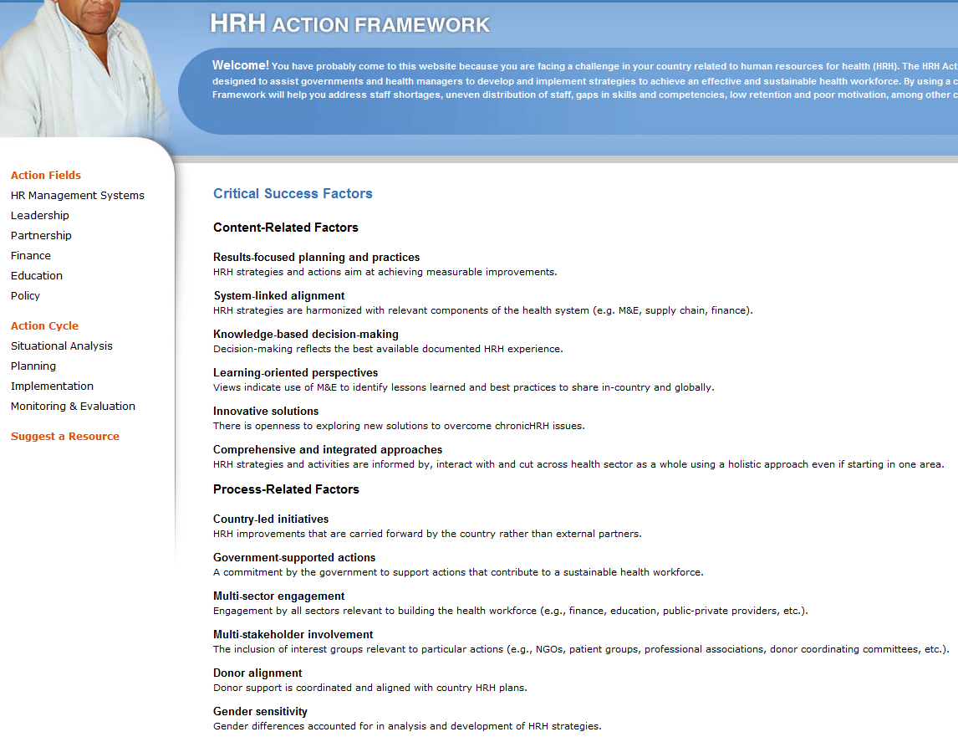
Review critical success factors
Notes:
The advice is not to jump into HR issues straight away, but we review the all-important critical success factors at: http://www.capacityproject.org/framework/critical-success-factors/
Some of these factors may seems obvious, but are often forgotten, so it is good to return to this section frequently.

Slide 20
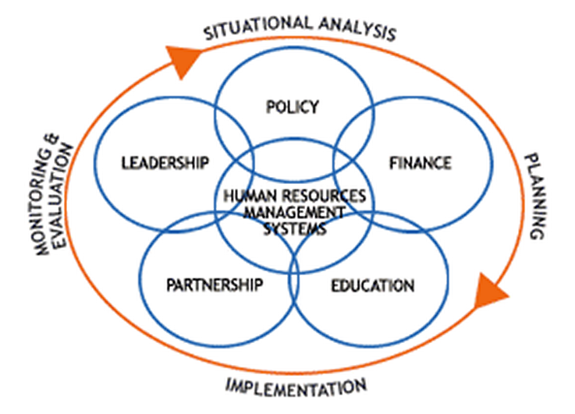
Identify location on action cycle
Notes:
You might then want to decide where your current situation fits on the Action cycle. Click on http://www.capacityproject.org/framework/action-cycle/#implementation to get the explanations of the various phases.
This will help you determine what the HAF can help you with. If you’re at the stage of planning a situation analysis, it will help you decide on the questions you want answered to understand the current situations and the causal relationships. If you are developing a plan it will help you to decide on who to involve in the process and what to put in the plan.

Slide 21
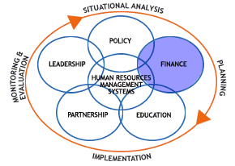
Start with one of the Action fields (1)
Notes:
Start with one of the action fields e.g. Finance http://www.capacityproject.org/framework/finance/ (you can also follow this on the one-page handout distributed)
Here you can see the definition of the action field (not included in the handout): “Obtaining, allocating and disbursing adequate funding for human resources.”
Then the suggested areas of intervention e.g. ‘setting levels of salaries and allowances’ [note the handout only has ‘salaries and allowances’; the text has been revised a little since then]. Has this been done? Does it need to be done? Who has the power to decide? What information do they need to make this decision?
Then a few key indicators are provided e.g.: “Salaries and allowances competitive in local labor market” – this will help with the decision about whether or not to re-set the levels of salary and allowances.
Continued on next slide .....

Slide 22
Start with one of the Action fields (2)
Notes:
Continued from previous slide .....
For each action field there is a list of relevant tools and guidelines. For example, under Finance you will find a tool for assessing your organisation’s capacity to manage it’s finances – which would include HR-related finances. Then there is a document about performance-based financing.
These resources can be down downloaded for later use.

Slide 23

How can we use the HAF?
Notes:
It is not always easy to get a very clear description of exactly how people have used it, as more a way of guiding a thinking process – which is the role of a framework.
A meeting was held in Amsterdam in May this year to review some of the experiences of the use of the HAF.
These are a few of the examples that were reported, but please don’t see them as limiting as the HAF inspires creativity!

Slide 24
Guiding a planning process
Notes:
The most extensive use of the HAF for planning purpose took place over several years in Uganda.
Working groups were established for each of the Action Fields to review the situation. The process led to the challenging of a recently agreed HR plan with very conservative staffing targets. On the basis of the analysis of targets for health outcomes and service delivery requirements to meet them, the staffing targets were revised.
Advocacy as a result of using the HAF, supported by the analysis of staff requirements, contributed to Uganda receiving a loan from the World Bank for $100 million to support HR and health systems strengthening.

Slide 25
Assessment framework or reporting structure
Notes:
A programme to strengthen TB control used the HAF to guide a SWOT analysis – which links to the situation analysis part of the action cycle
In Vietnam the HAF was used to structure an assessment tool to identify potential areas of HR for strengthening (also at the situation analysis stage).
In Afghanistan the existing HR plan was reviewed against the HAF to check it’s level of comprehensiveness (a form of M&E of the plan, rather than implementation). No major problems were identified.
In NE Kenya, the HAF was used to guide a situation analysis and to structure the report of the findings to increase clarity of the messages.

Slide 26
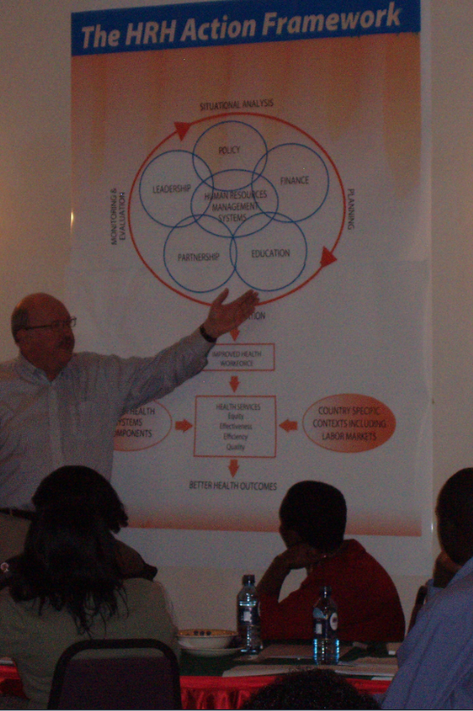
Advocacy, promoting informed dialogue and training
Or Kenya training photo
Notes:
The Uganda example demonstrated how the HAF – when used with supporting data – can be an effective advocacy tool.
In several examples users felt the process of using it helped to inform dialogue. In fact I was involved in developing and conducting a series of workshops on HR in Kenya. Not only did we use the HAF to develop the structure of the workshops, we also used it every workshop to show how the various topics being covered contributed to improved HR (see picture-.
HAF now included in some training curricula in Peru.
To sum up ...

Slide 27
Using the HAF will help clarify the complex area of HRH

Slide 28
You can then develop and use more effective strategies to improve HRH

Slide 29
And your success will contribute to the many reasons for using the HAF!
100,000,000
+ 1

